Slide 1

Progress Presentation
25-09-2024
Prepared by: Marie Joe Sawma To: Dr. Reed Maxwell

Slide 2
Content
Summary of Previous Meeting
Discussion of Simulation-Based Inference for Parameter Estimation of Complex Watershed Simulators (p.15)
Monday Meeting
Ameri-flux
Subset-tools
Next Week Plan
Time Management/ Schedule

Slide 3
Summary of Previous Meeting
Discussion of Physics Informed Paper
Discussion of the limitations of applying deep learning
Advantages of implementing Machine Learning (ML)
Discussion of CLM Model
Deep learning for short term vs long term

Slide 4
Simulation-Based Inference for Parameter Estimation of Complex Watershed Simulators
Limitations :
Types of computational Demands and Complex Responses that made the calibration of PB simulators infeasible .
Relation between the Conditional Probability and the complex responses of simulators.

Slide 5
Mechanism of Simulation-Based Inference: Parameter Estimation and Model Calibration
The SBI works by learning the relationship between the model's parameters (inputs) and the observed data. It identifies how changes in these parameters affect the model's output by running many simulations and comparing the results with real-world data. Once this relationship is understood, SBI can estimate the best parameters that explain the observed data.

Slide 6
Process Based Simulators (PB)
The process-based simulators are physical-based model, used to represent hydrologic states and fluxes at multiple scale.

Slide 7
Questions
Employ a density-based neural network to represent the joint probability of parameters and data without strong assumption about its functional form (p.1)
Performing weighting approach to the SBI framework (p.1)
How the PB simulators are widely employed in the study of complex catchment processes and their responses to a changing climate while their calibrations remain a significant challenges (p.1)

Slide 8
Questions
How the performance of the SBI can be assessed by studying the relationship between the surrogate and PB emulators as a proxy for the real case? (p.2)
How does the neural network work to estimate and understand the model? (p.3)
When the deep learning is combined with the physical mode, how the neural will be able to use these two models to predict the values? (p.3)
What is the model configuration?
What is the main difference between the CONUS 1 and CONUS 2 data?

Slide 9
Questions

Slide 10
Discussion Monday Meeting
Numerical Computations in Par flow
Implement an Emulator (SBI) to faster the computational phase.
Sequential Method in SBI that consists of narrowing the range of observations (computationally expensive).
Emulator is trained on Par flow Behavior , and hence the performance of the Par flow can be the same as the Par Flow model or less.
Creating a vector for each sample member (each point has its own vector which illustrate the streamflow for 30-days for example).

Slide 11
Discussion Monday Meeting
SBI looks to the vector (can be streamflow or Manning’s Values) that are given and try to understand the relation between the different parameters to be able to start by prediction of values.
It starts to understand the distribution within the vector based on the simulation and starts by predicting the result.
SBI means that we are inferring what are the parameters are based on close are the simulated values are to the observed values.
Shrinking the range is just to speed up the model and save computationally steps.

Slide 12
Discussion Monday Meeting
Discussion of the simulation-images and the total number of runs of simulations and accuracy of results.
Discussion of the Manning’s vector and its different groups.
After getting these values, streamflow hydrograph and comparing it to the observations (as much as it gets tighter to the observational data , as much as the result from the simulation is correct).

Slide 13
Coding: General Overview
To run the code : you just need to change the HUG that you need to deal with, start date, and end date.
Run the Scripts
First part of the code is setting up of the baseline run the thirty day period with all the same setting that in the conus 2 domain on hydro-data .
Second part: reads distribution, draw sample, sets up all the folder to you to run.
Third part: evaluating the sample where the SBI takes place , so everything before were about the Par Flow part. All the previous parts are from the Par Flow . In the third part , we are just loading our inferences and vector of data , a little bit of plotting.
Model run config in settings.json
2. create_ensemble.py line 17, change path to json
3. evaluate_ensemble.py, line 15, change json path
Static data from your run
Get rid of the hourly data and just keep the daily data (to save time in running) by averaging the hourly data and deleting the hourly files
Hydro-data and from the simulation

Slide 14
Total number of Simulations as one sample and set a number then analyze it

Slide 15
Monday Meeting
SBI _ Prototype Slack Channel
GIT HUB Subscription
Add me to the GIT HUB (Private Account) + message on Slack to add me on the GIT HUB
Schedule a Meeting before start working on GIT HUB
Get familiar with the code
Third step is to do a step example (try to run a simulation like the one that I saw them on the graphs)
Working on different branches on GIT HUB

Slide 16
Ameri-flux / Subset-Tools
Ameri flux Energy Fluxes Point Data
Ameri flux can’t be an input for Par flow
Subset-Tools Grid Level

Slide 17
Ameri Flux / Subset-Tools
Difference between Conus 1 and Conus 2.
Conus 2 is not simulated yet in the Par flow.
Gridded data can be taken from satellites measurements, assumptions or other instruments of measurements.
Subset-Tools does not have a function that calls the Ameri-Flux

Slide 18
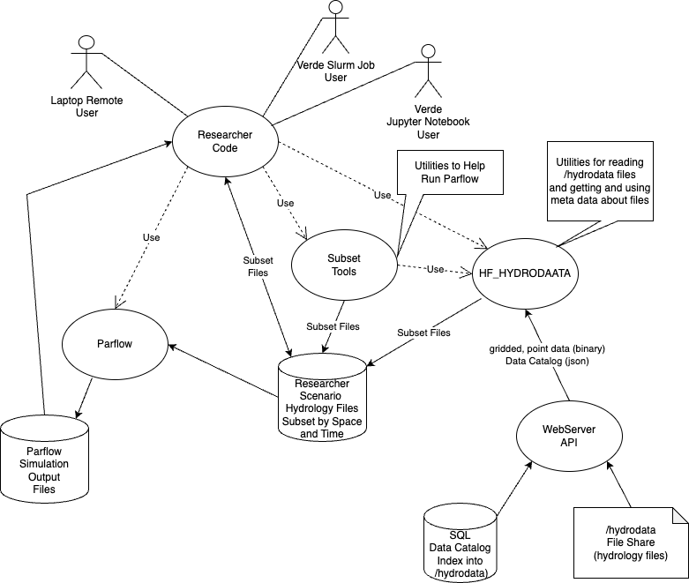
Ameri Flux/ Subset-Tools
Thanks to Willian Hassling

Slide 19
Plans for Next Two Week
Reading another paper + mention the name of the paper
Starts by understanding the model and the manuscript that I will deal with
Schedule a meeting with Amanda to get more involved in the project

Slide 20
Stochastic Hydrological Models
Regression
Transfer Functions
Neural Networks (I am very interested in this model and how it works)
System Identification
Transfer functions

